Slide 1

“HEART DISEASES PREDICTION USING SUPERVISED LEARNING ALGORITHMS” Internship Based Project Report Submitted To Chhattisgarh Swami Vivekanand Technical University, Bhilai for Completion of 6th Semester Internship of the degree of BACHELOR OF TECHNOLOGY (HONORS) In ARTIFICIAL INTELLIGENCE (COMPUTER SCIENCE & ENGINEERING) By Ruchi Shukla B.Tech.(Hon) 6th Semester Roll No: 300012721005 Enrollment No: CB4598 Under the Guidance of Ramakant Ganjeshwar Assistant Professor (AI/DS) Computer Science and Engineering CSVTU, Bhilai (CG)

Slide 2
TABLE OF CONTENTS
Internship Company Profile
Introduction
Objective
Literature Review
Methodology
Workflow
Deployment
Future Scope
Application
References

Slide 3

INTERNSHIP COMPANY PROFILE
Onet Infotech, a prominent IT company based in Bhilai-Durg, Chhattisgarh, excels in software development, website design, and industrial automation solutions. With a commitment to innovation and customer-centric service, it caters to a diverse clientele from local businesses to international corporations.
Key Features
Diverse Service Offerings
Certifications and Training
Strategic Growth
Employee Engagement
Recognition and Standards

Slide 4
INTRODUCTION
Heart disease, including coronary artery disease, heart defects, infections, and heart failure, is a leading global cause of death, often triggered by high blood pressure, high cholesterol, smoking, and a sedentary lifestyle.
Machine learning aids in heart disease prevention and management by analyzing medical data to identify patterns, predict risks, and guide personalized treatments.

Slide 5
OBJECTIVE
Our project's goal is to leverage data analysis and machine learning to proactively mitigate heart disease.
Through advanced data analysis techniques, we aim to uncover critical insights about heart disease, identifying key risk factors and discernible trends.
Utilizing these insights, we will develop a predictive machine learning algorithm to assess an individual's probability of developing heart disease.
This algorithm will be seamlessly integrated into a Django-based platform, enabling users to input their demographic and lifestyle information and receive personalized predictions.

Slide 6
LITERATURE REVIEW
AUTHOR | TITLE | PURPOSE | ALGORITHMS USED AND ACCURACY
1)Nadikatla Chandrasekhar,Samineni Pedda Krishna | Heart Disease Prediction Using Machine Learning -2023 | The project aims to develop an accurate model for early heart disease detection using advanced machine learning techniques like Gridsearch CV tuning, five-fold cross-validation, and an ensemble voting classifier. This seeks to improve early diagnosis and patient outcomes. | Random Forest - 70% KNN-60% Logistic - Regression-72.90% Naive Bayes-55%
‹#›

Slide 7
HEART DISEASES
What is Heart Diseases.
Heart disease describes a range of conditions that affect the heart. Heart diseases include- Blood vessel disease, such as coronary artery disease Irregular heartbeats (arrhythmias) Heart problems you're born with (congenital heart defects) Disease of the heart muscle Heart valve disease.
Types of Heart Diseases.
Coronary Artery Disease (CAD)
Heart Arrhythmias
Heart Failure
Heart Valve Disease
Pericardial Disease
Cardiomyopathy (Heart Muscle Disease)
Congenital Heart Disease

Slide 8
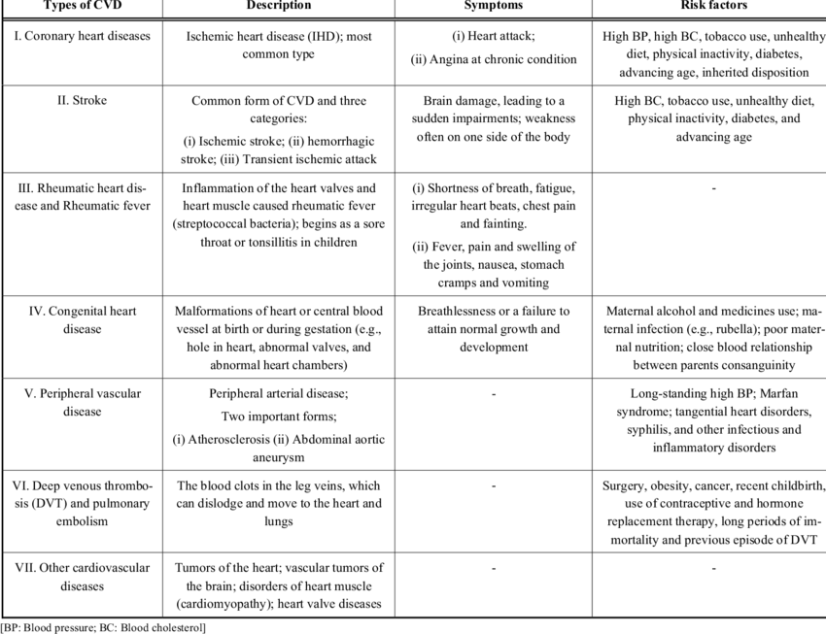
Fig I Types of Diseases & Symptoms

Slide 9
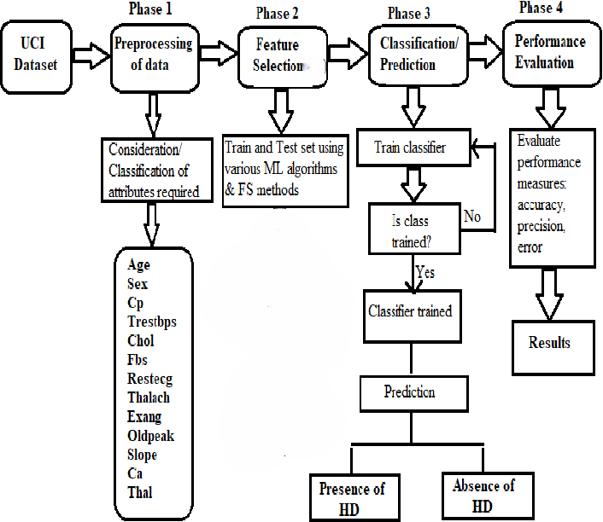
METHODOLOGY
WorkFlow

Slide 10
METHODOLOGY
Data Collection
Collecting heart disease data is challenging due to privacy concerns, making direct web scraping impractical. Instead, reliable sources like UCI and Kaggle offer ethically collected, high-quality datasets that ensure data quality and confidentiality.
In these Project 300 Dataset are used.
Table I : Features Names
S.No. | FEATURES NAMES
1. | Age
2. | Gender
3. | Chest Pain Types
4. | Resting Blood Pressure
5. | Serum Cholesterol
6. | Fasting Blood Sugar
7. | Resting Electrocardiogram
8. | Max rate Heart achieved
S.No. | FEATURES NAMES
9. | Exercise Induced Angina
10. | ST Depression Induced By Exercise Relative To Rest
11. | Slope Of The Peak Exercise ST Segment
12. | Number Of Major Vessels Colored By Fluoroscopy
13. | Displays The Thalassemia

Slide 11
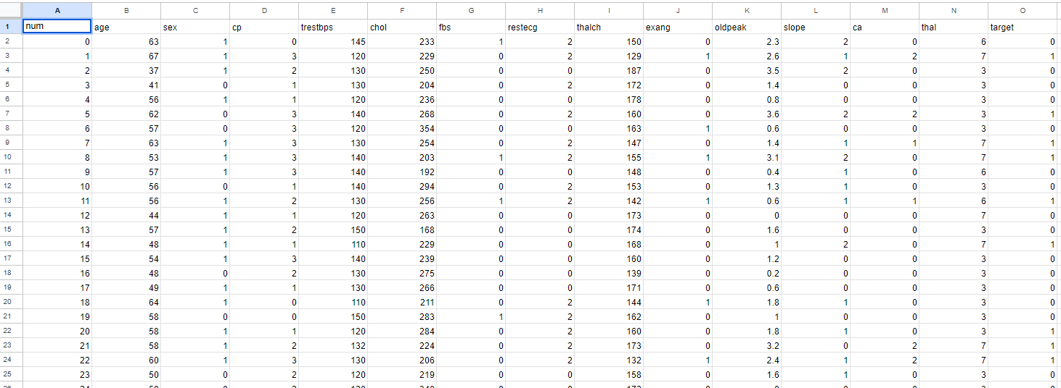
Dataset Description.
The dataset includes information on factors affecting heart health, such as patient demographics, medical history, and lifestyle habits. This data is valuable for researching heart disease trends and risk factors.
Additionally, it details the type and severity of heart disease in each patient and any treatments they have received, providing comprehensive insights for analysis.
Figure II UCI File Format

Slide 12
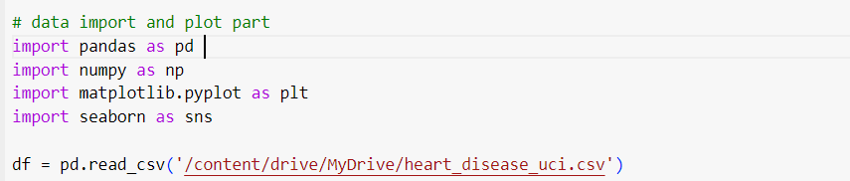
DATA PREPROCESSING
Exploratory Data Analysis (EDA)
Exploratory Data Analysis (EDA) is crucial in any data science project as it involves cleaning, preparing, and uncovering patterns and relationships in the data for further analysis.
Read the Data.
In a heart disease prediction project, the initial step is to import essential libraries like Pandas and Numpy for data manipulation and analysis, and then load the dataset, typically a CSV file, into a Pandas DataFrame.
FIG III. Read the data

Slide 13
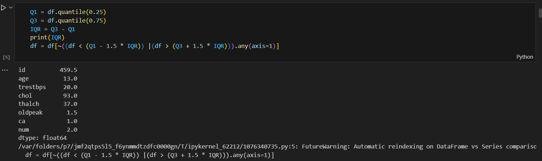
Removing Outliers.
Outliers, which are extreme values that can distort statistical analyses, must be identified and removed, often using the Interquartile Range (IQR) method.
FIG-IV Removing outliers

Slide 14
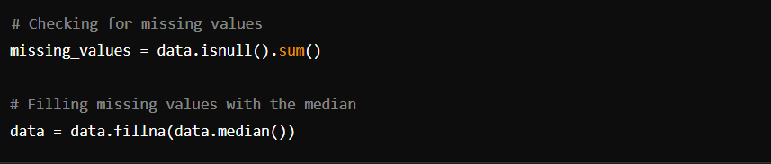
Handling Missing Values.
Missing values can skew results and must be addressed. Different strategies, such as imputing with mean, median, or mode, are used to fill missing values.
Fig- V Handling Missing Values

Slide 15
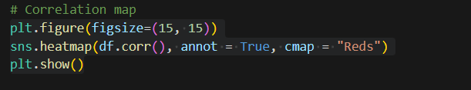
Data Visualization.
Data visualization is vital for uncovering patterns and relationships within the data. Various visualizations, such as histograms and scatter plots, can be employed to analyze the distribution of variables like age, blood pressure, and their relationship to heart disease.
FIG-VI Correlation map

Slide 16
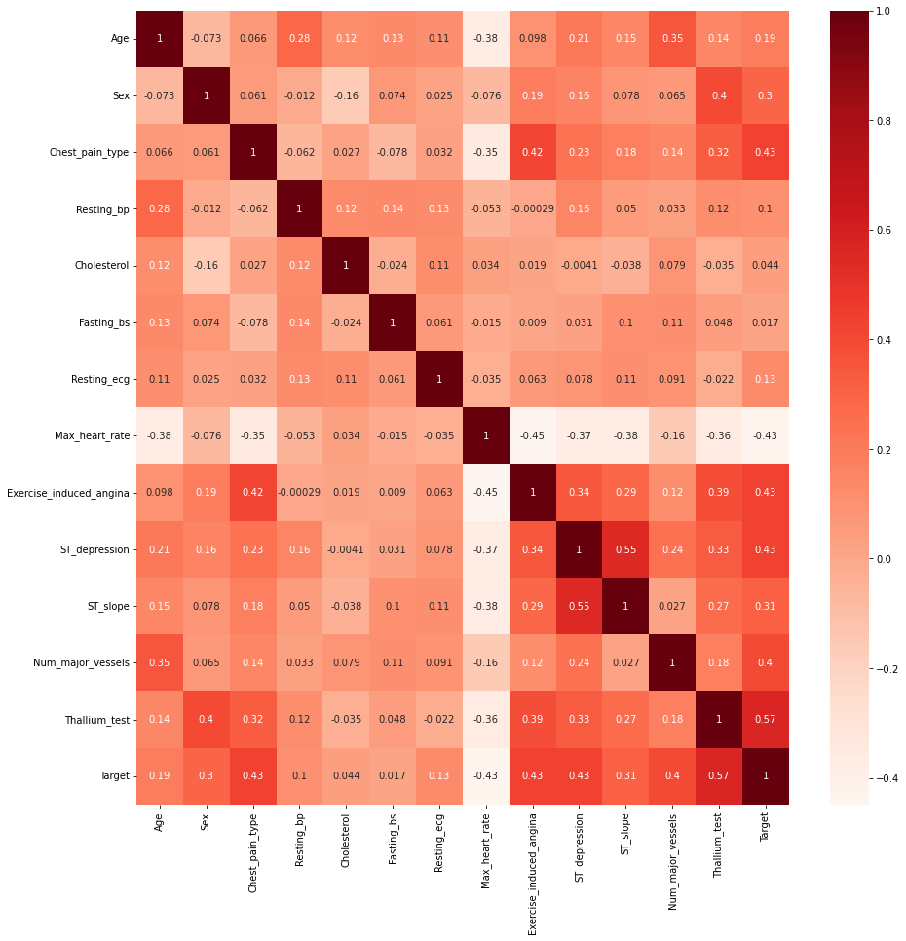
FIG-VII Output

Slide 17
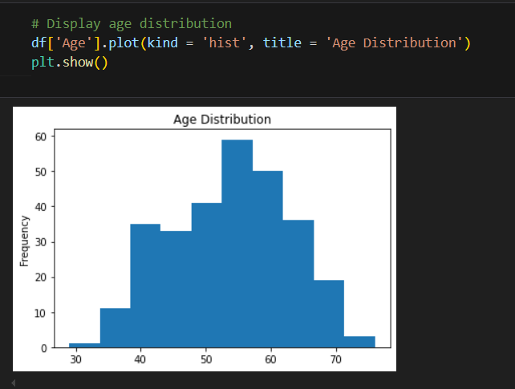
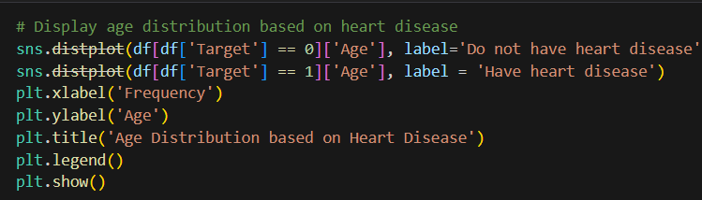
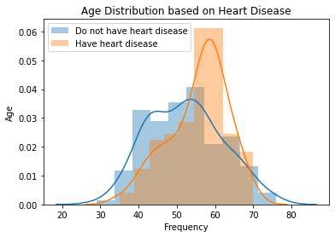
Visualizing Age Distribution and Heart Disease Relationship
FIG-VIII Data Visualization

Slide 18
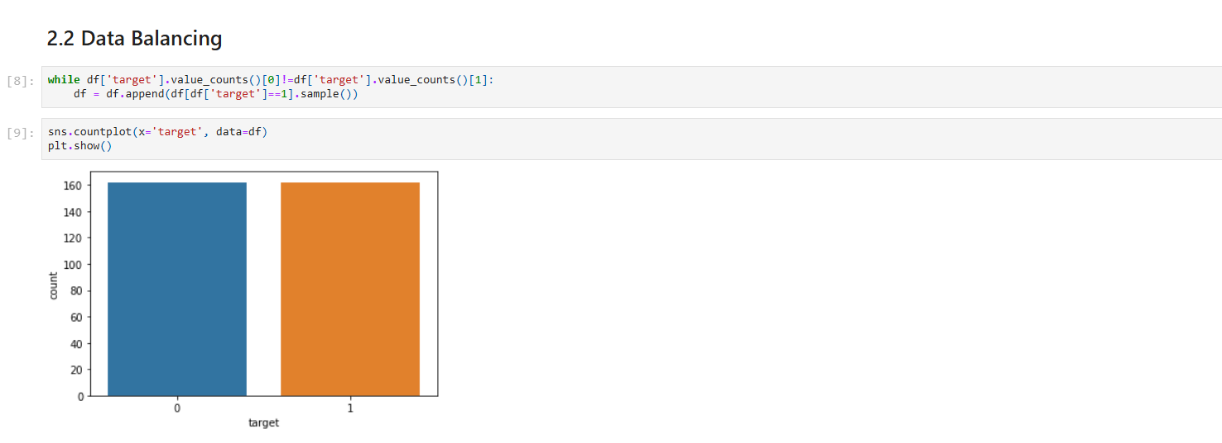
FEATURE ENGINEERING
1. Data Balancing
Our dataset is unbalanced, with fewer 1's (indicating heart disease) than 0's. To address this, we randomly select and add rows with targets equal to 1 to balance the number of 0's and 1's.
A balanced dataset is crucial in machine learning as it helps the model classify target classes accurately, reducing bias and improving overall predictions, especially for heart disease.
FIG-IX Data Balancing

Slide 19

2. Data Splitting
We split the heart disease dataset into 70% training and 30% test sets. Dividing a dataset this way allows us to train the model on one subset and evaluate its performance on an independent subset.
This is essential for developing accurate and reliable machine learning models for heart disease prediction.
Fig-X Data Splitting
3. Data Normalization
Data normalization transforms a dataset into a more suitable form for analysis, making it consistent and easier to work with.
This process improves the accuracy and reliability of statistical analyses and machine learning models, and helps identify and remove errors or inconsistencies.

Slide 20
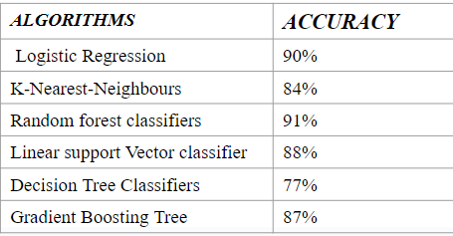
MODEL TRAINING & EVALUATION
Model Training
Model training for heart disease prediction involves building machine learning models using algorithms like logistic regression, SVM, kNN, decision trees, random forests, and gradient boosting.
Models are trained by applying selected algorithms to prepared data, adjusting parameters to optimize performance.
Table II - Algorithm used

Slide 21
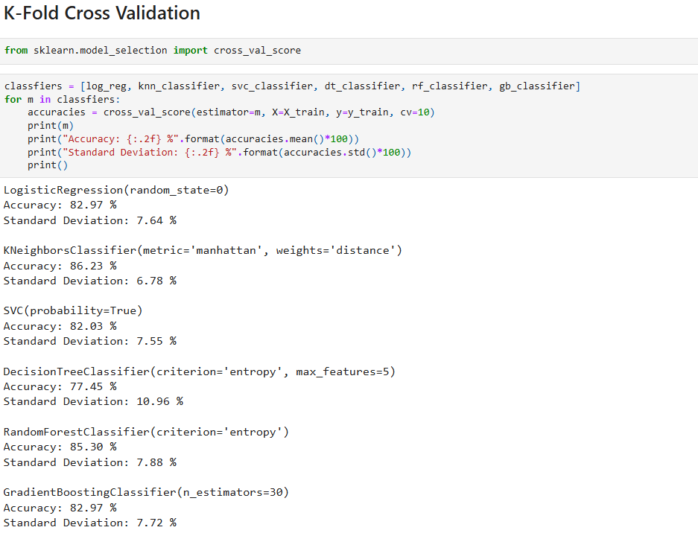
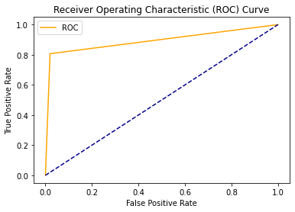
Model Evaluation
Confusion Matrix & Classification Report
ROC-AUC
K-Fold Cross-Validation
Fig-XI Models Used

Slide 22
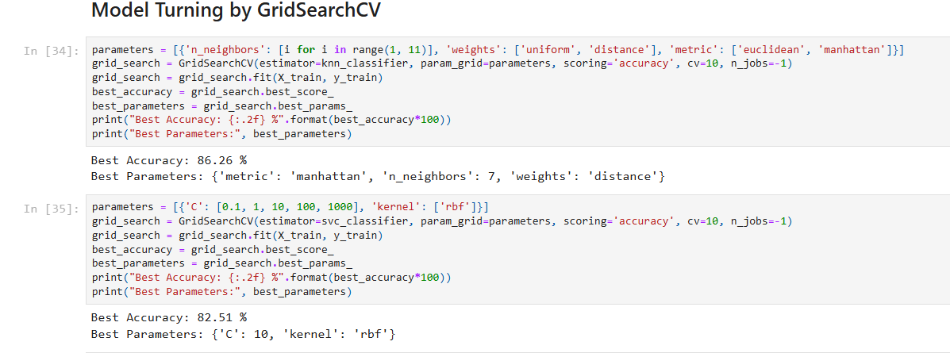
MODEL TUNING
Model Tuning Principle.
Model tuning for the heart disease dataset involves using GridSearchCV to find the best model parameters. The dataset is split into training and validation sets, and various parameter combinations are used to train the model.
The best-performing model on the validation set is chosen as the final model, which is then used for predictions on new data.
FIG-XII Model Tuning

Slide 23
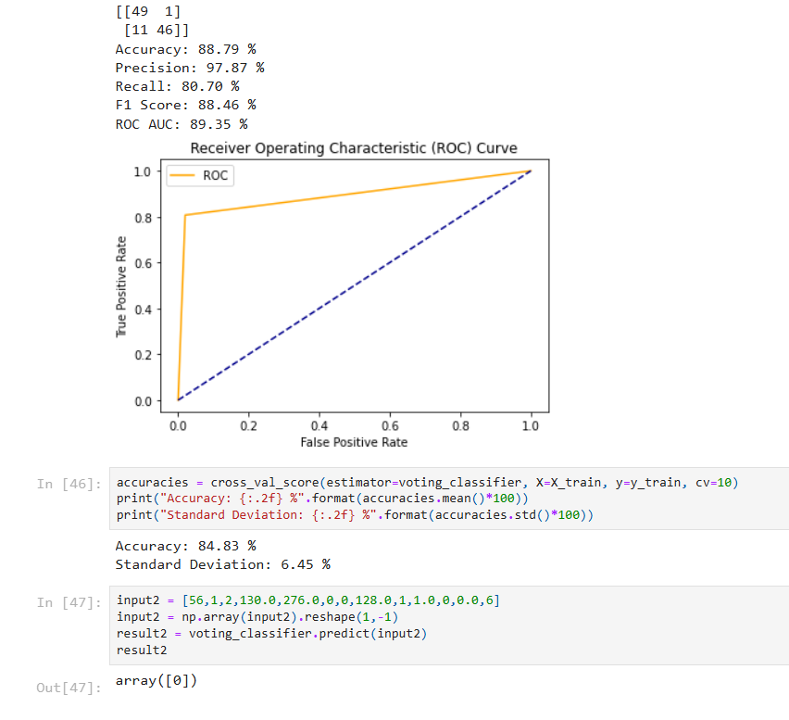
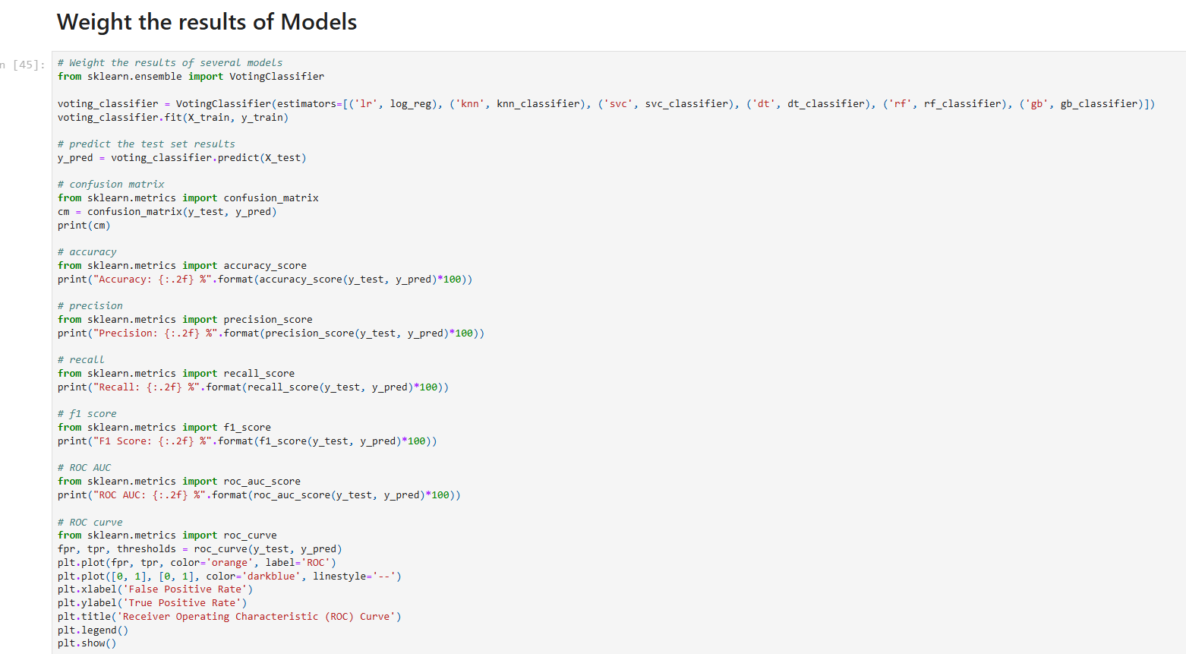
MODEL WEIGHTING
1. To combine the predictions of multiple models, we use ensemble learning with a VotingClassifier.
2. This involves training several models, such as logistic regression, SVM, KNN, decision trees, random forests, and gradient boosting, and then combining their predictions by majority vote.
3. Different weights can be assigned to each model's contribution, leveraging their strengths and reducing overfitting.
Fig-XIII Models Weighting

Slide 24
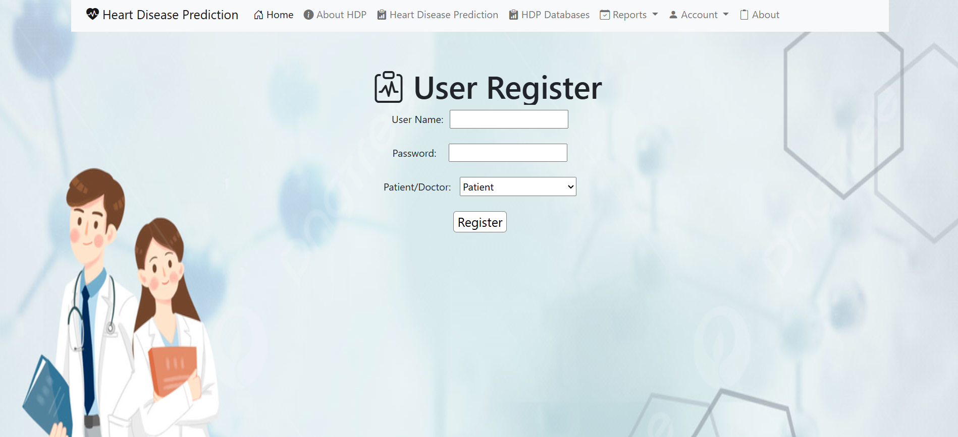
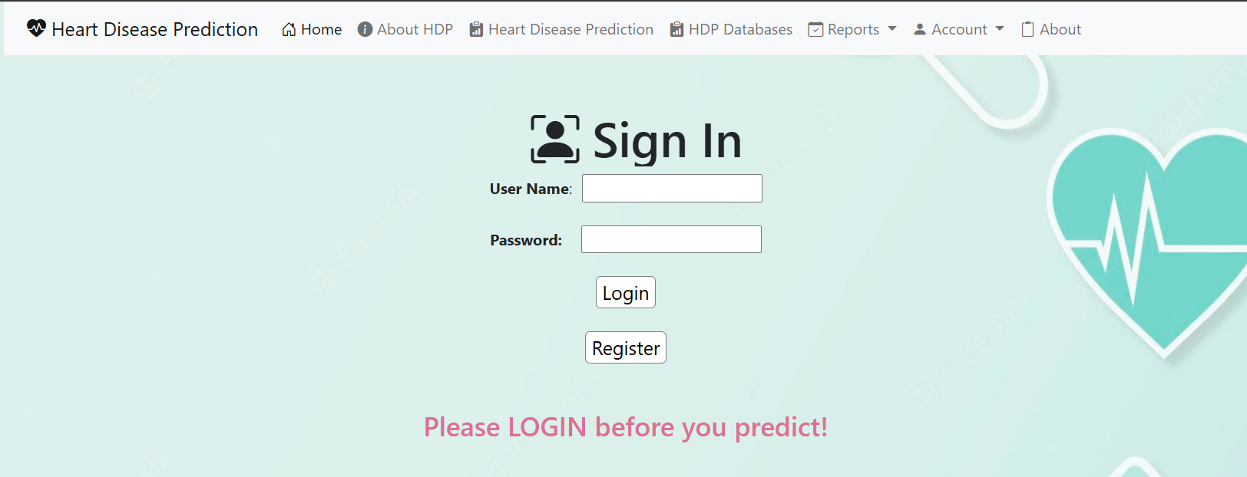
DEPLOYMENT
Our Django website allows users to learn more about heart disease and its potential risks.
Login & Register
Our website features a login and registration screen where users can enter a username, password (hidden), and select their identity (patient, caregiver, doctor).
Fig-XIV Login & Register Page

Slide 25
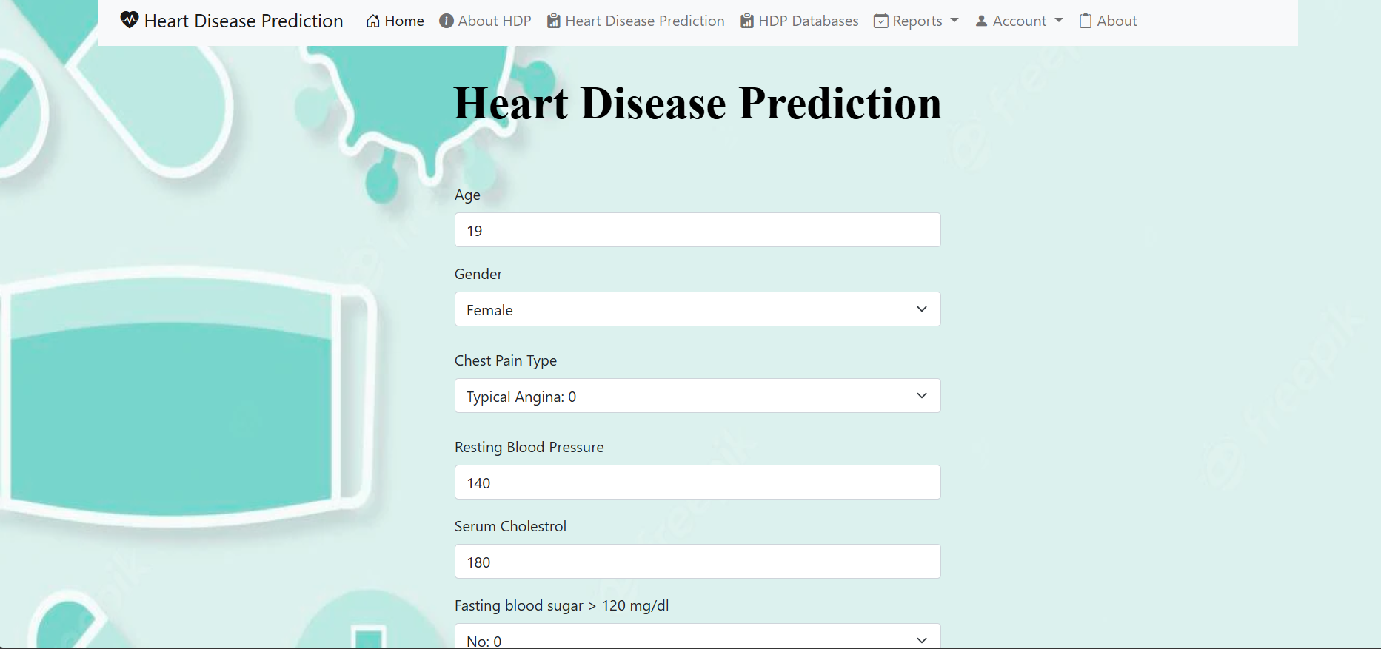
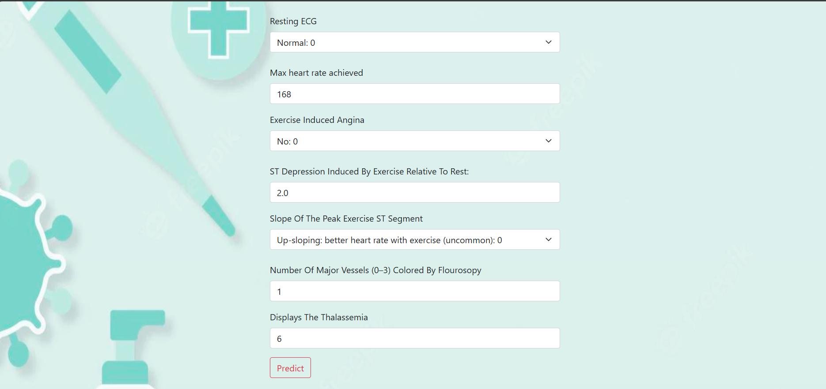
HEART DISEASES PREDICTION
One key feature of our Django website is its predictive tool using machine learning algorithms trained on cleaned heart disease data to assess a user's risk for developing heart disease, aiding informed health decisions.
Fig-XVI Heart Disease Prediction

Slide 26
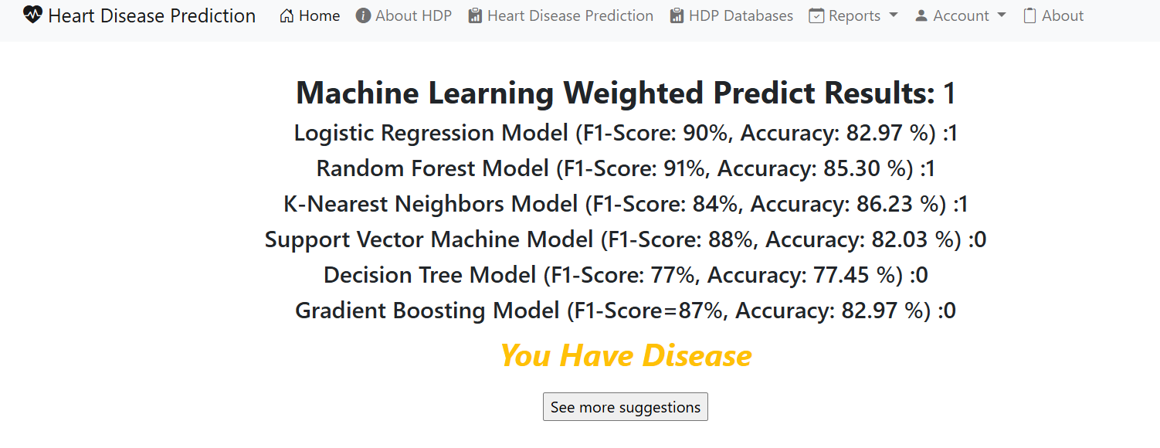
Fig-XV Output of Random Data

Slide 27
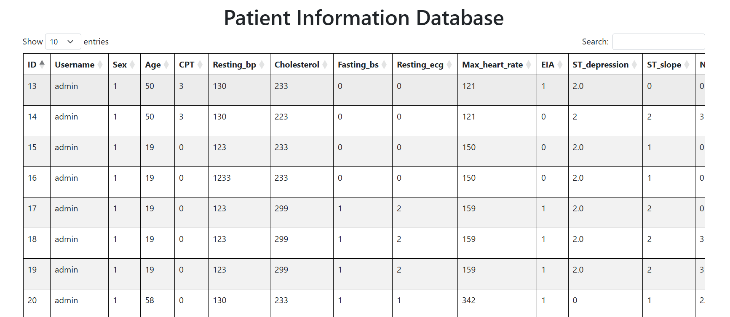
HDP DATABASE
Our Django website enhances patient care by offering doctors easy access to patient data, thereby improving care efficiency and effectiveness in managing heart disease.
Fig-XVI Patient Database

Slide 28
FUTURE SCOPE
Enhanced predictive accuracy with advanced algorithms and ensemble methods.
Personalized treatment plans incorporating genetic, lifestyle, and environmental factors.
Real-time health monitoring through IoT devices and wearables.
Integration with Electronic Health Records (EHR) for comprehensive patient analysis.
Expansion of prediction models to other cardiovascular conditions.

Slide 29
APPLICATION
Hospital and Clinical Settings
Primary Care
Telemedicine
Personal Health Apps
Insurance Industry
Public Health Initiatives
Research and Development
Workplace Health Programs
Home Healthcare Devices

Slide 30
REFERENCES
[1] Yahaya, L., Oye, N. D., & Garba, E. J. (2020). A comprehensive review on heart disease prediction using data mining and machine learning techniques. *American Journal of Artificial Intelligence*, *4*(1), 20-29.
[2] Sekar, J., Aruchamy, P., Sulaima Lebbe Abdul, H., Mohammed, A. S., & Khamuruddeen, S. (2022). An efficient clinical support system for heart disease prediction using TANFIS classifier. *Computational Intelligence*, *38*(2), 610-640.
[3] Ramalingam, V. V., Dandapath, A., & Raja, M. K. (2018). Heart disease prediction using machine learning techniques: a survey. *International Journal of Engineering & Technology*, *7*(2.8), 684-687.
[4] Narkhede, S. (2018). Understanding auc-roc curve. *Towards Data Science*, *26*(1), 220-227.
[5] Huang, J., & Ling, C. X. (2005). Using AUC and accuracy in evaluating learning algorithms. *IEEE Transactions on knowledge and Data Engineering*, *17*(3), 299-310.
[6] Fushiki, T. (2011). Estimation of prediction error by using K-fold cross-validation. *Statistics and Computing*, *21*(2), 137-146.
[7 ] Vladislavleva, E., Smits, G., & Den Hertog, D. (2009). On the importance of data balancing for symbolic regression. *IEEE Transactions on Evolutionary Computation*, *14*(2), 252-277.

Slide 31
THANK YOU

